Slide 1



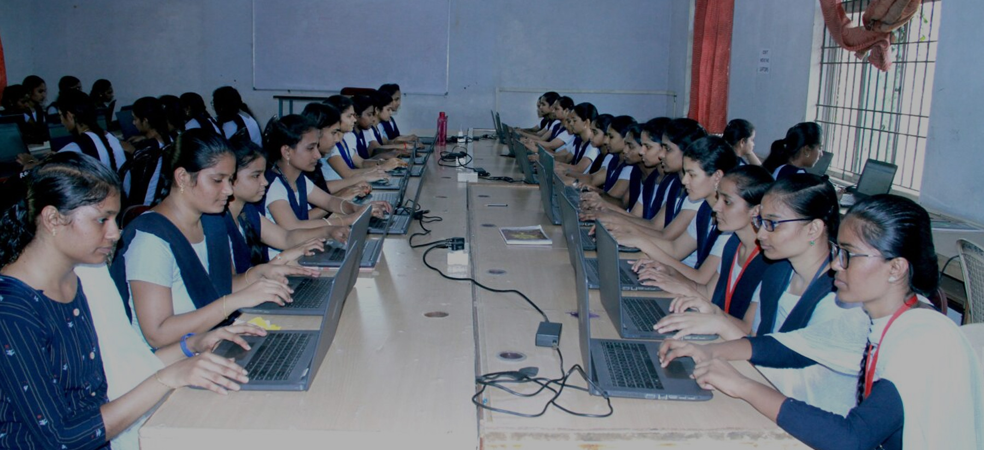
The real time analysis of bank customer
Project by -
Mentor Name
Name Institute
State
VARSHA SAHU
ABHISHEK G
NATIONAL SKILL TRAINING INSTITUTE BANGLORE
KARNATAKA

Slide 2

Agenda
Problem Statement
Who are the end Users
Proposed solutions
Wow Analytics in the solution
Dashboard Demonstration
Q&A
Notes:
project overview provides stakeholders and team members with a clear understanding of the project's purpose, scope, and expectations, setting the stage for successful project execution and delivery.

Slide 3

Problem statement
To keep track of all the balance by region
Finding job classification based on balance is quite difficult to see through data
To find out based on gender of job classification and balance is difficult
Notes:
aim to leverage Power BI's capabilities to transform data into actionable insights, drive business performance, and support organizational goals and objectives.

Slide 4


Who are the end users
Bank staff
Customers
Management
Stakeholders

Slide 5


Proposed Solution
To keep track of all balance by region we check in pie chart to find top 5.
the Job classification based on balance we find in bar chat.
Gender of Job classification and Balance we use column chat.

Slide 6
Wow Analytics in the Solution
During our analysis we can find that white color has more balance following we have blue color and others.
Based on region England has more balance is 84.83M
We can also see gender.

Slide 7
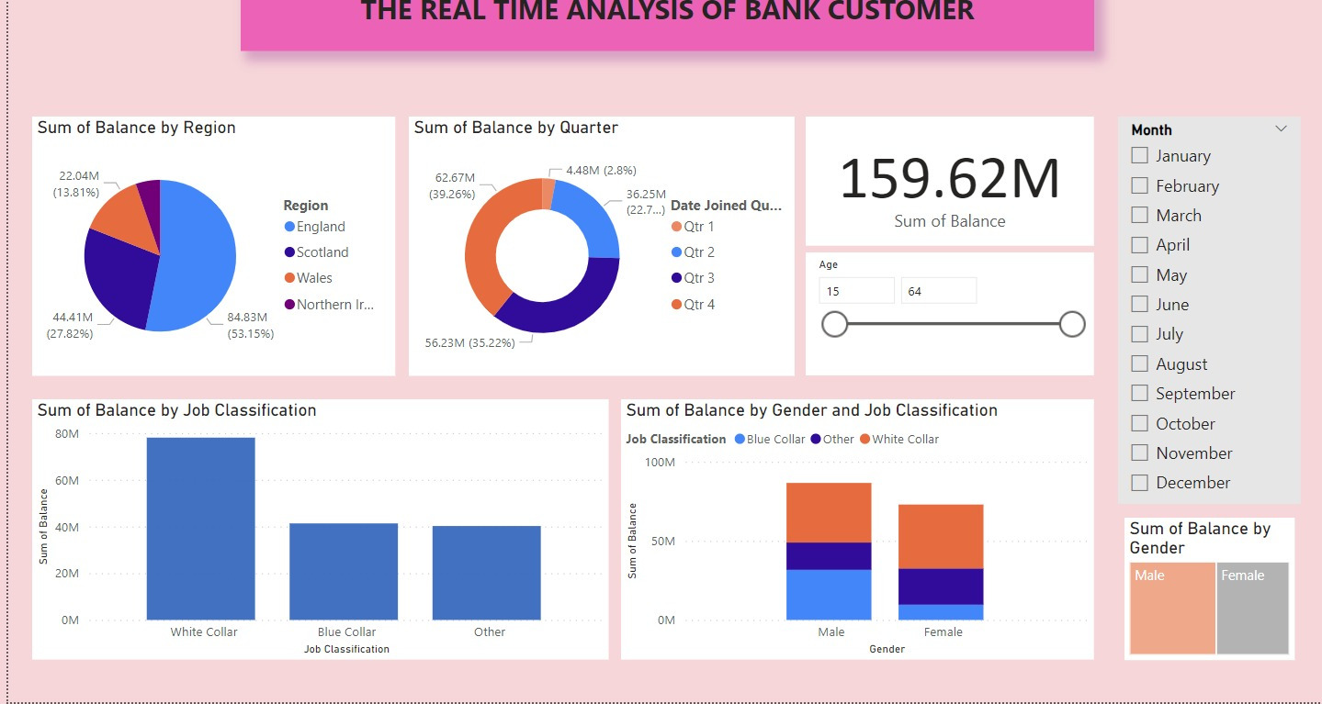
Dashboard Demonstration
Sum of Balance by Region
Sum of Balance by Quarter
Sum of Balance by Job Classification

Slide 8
Month and Quarter wise Gender Analysis Dashboard
sum of Balance by any Region
E.g. England
Female:0.6M
Sum of Balance by Job Classification
White colour : 78.07M
Blue colour : 41.33M
Other : 40.22M

Slide 9

Conclusion
Real-time analytics not only addresses current needs but also positions banks to be more adaptive and forward-looking.
This Photo by Unknown author is licensed under CC BY-SA-NC.

Slide 10
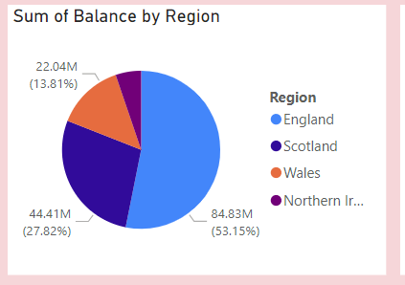
What is the balance of region in wales
44.41M
84.83M
22.04M
4.48M
Answer: 22.04M

Slide 11
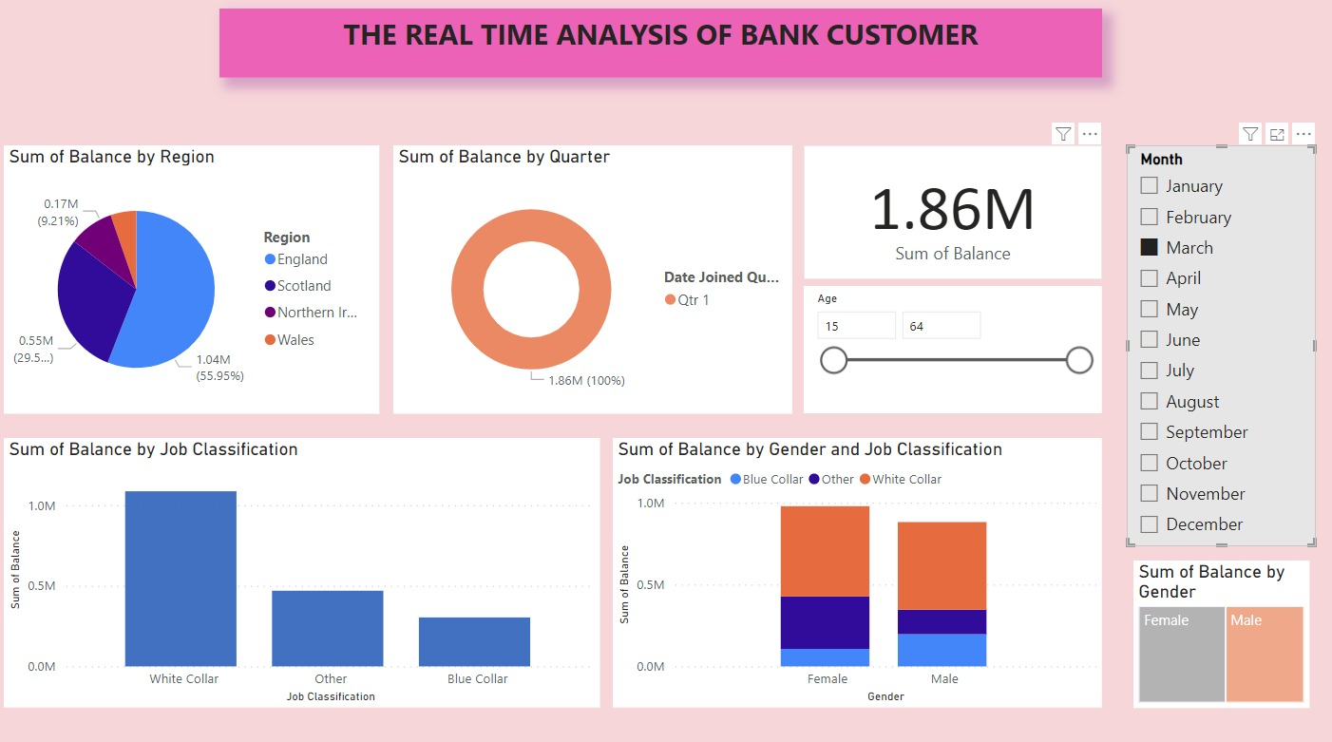
What is sum of balance of quarter in march
1.86M
62.6M
56.2M
36.2M
Answer:1.86M

Slide 12

Thank you

